Slide 1
CS 542 : Database Management Systems ​
Prof. Rodica Neamtu
Rootz
Adhiraj Budukh
Khushita Joshi
Juliana Porto
Julie Viera

Slide 2

Introduction
A website where users can find plants of their choice by using various filter options
Main application feature focuses on showing different plants to users as per their requirements
Example: Indoor plants for an offices based on room lighting (bright, medium, low, direct, etc.)

Slide 3

Features
Filter & Search Option
User Login
Favorite Plants
Comment on / Review Plants
Where to Purchase

Slide 4
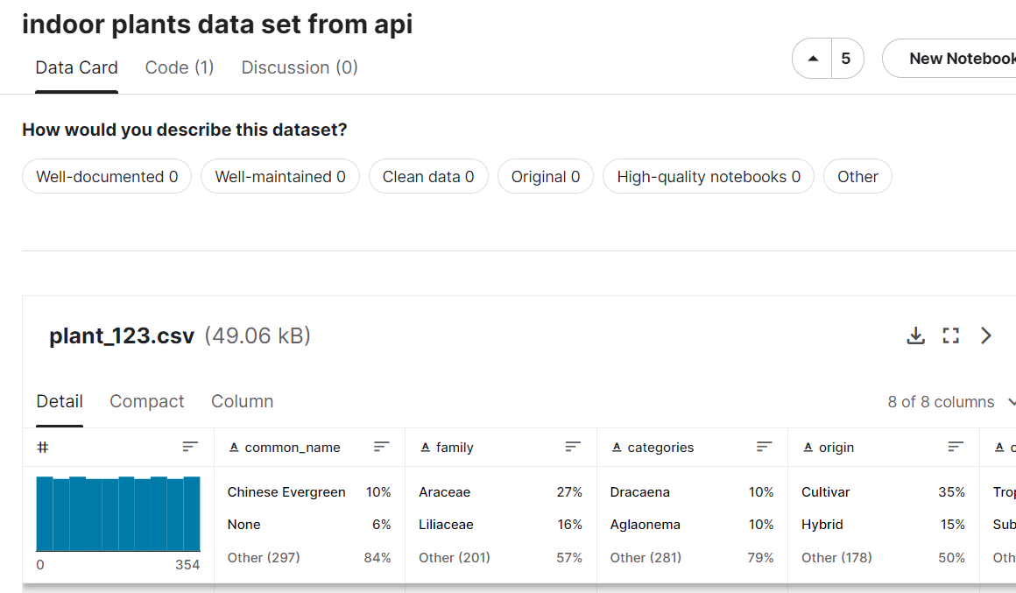
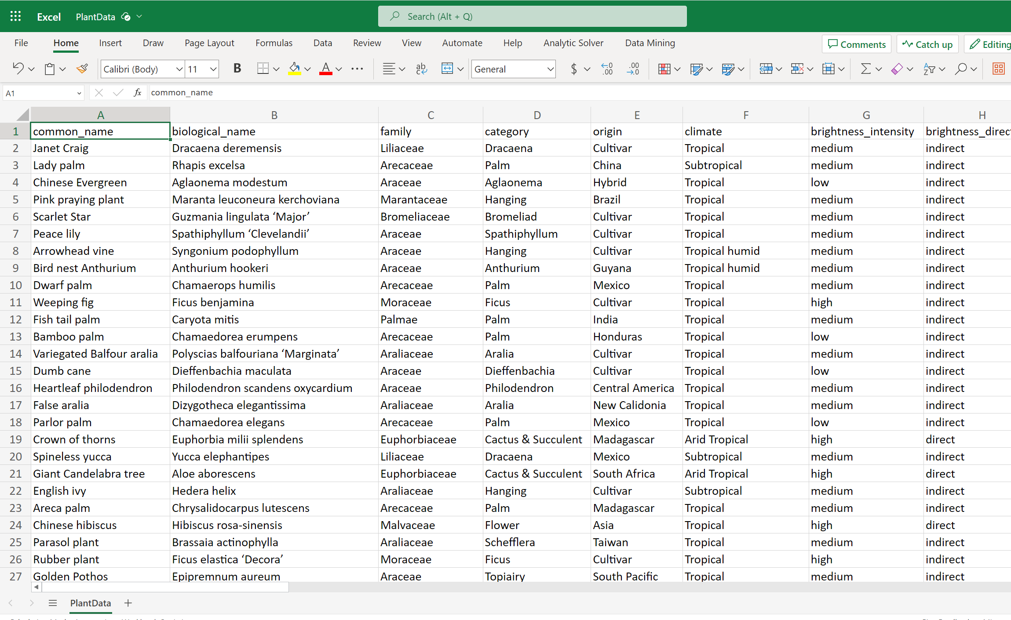
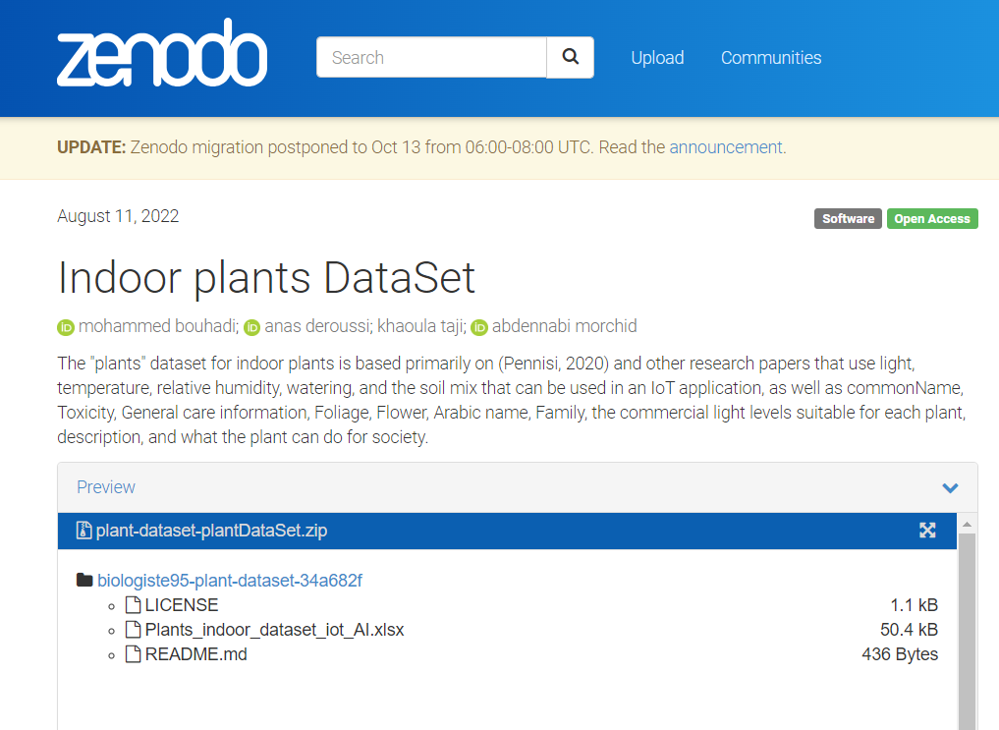
Dataset
13 columns (brightness, image url, etc.)
62 records

Slide 5
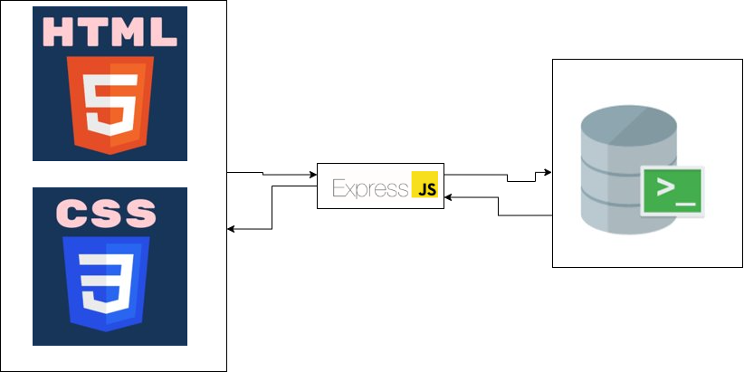
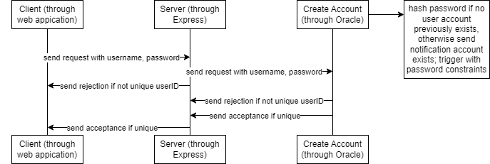
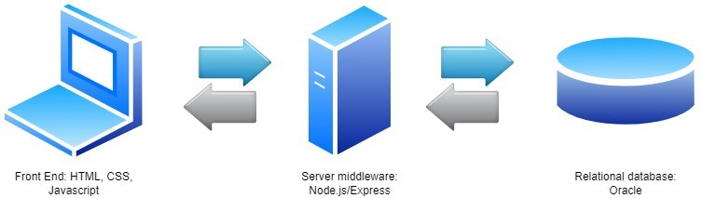
Architecture and Enviornmental Setup

Slide 6
THANK YOU
Notes:
This PowerPoint Template includes a series of slide masters with predefined layouts and color schemes for formatting slides
Slide Masters are displayed when you right click on a slide and select Layout from menu

